Slide 1
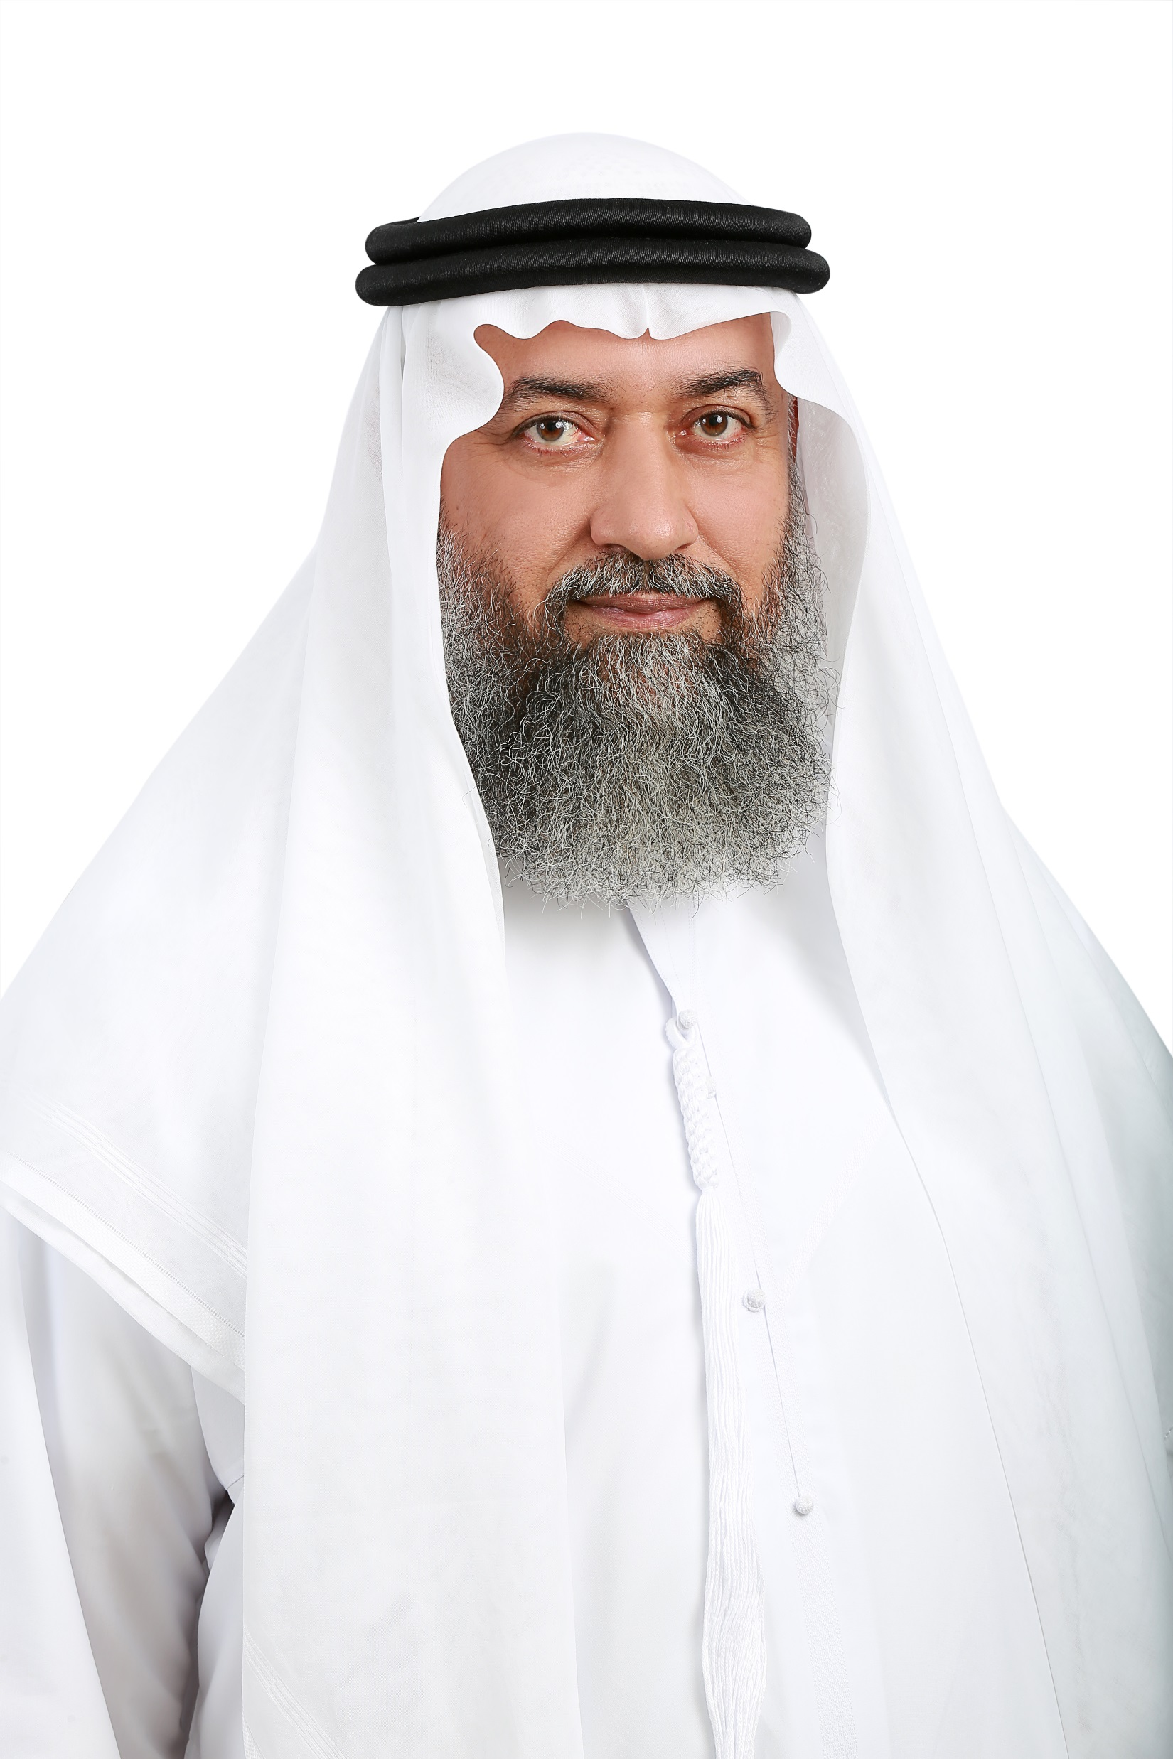
Mufti Aziz Ur Rehman
Islamic Scholar and Consultant

Slide 2
Macro
Micro
A real hope for poor
Finance

Slide 3
What are the reasons for poverty?

Slide 4
Today’s Civilizational Challenges
Climate changes. Global environmental changes
Exhaustion of natural resources
Loss of biodiversity and destructions of species
Economic instability
Wars and terrorism crises
Production of nuclear weapons
Hunger and food shortage
Widespread social unrest
Fasad Fil Ard

Slide 5
Fasad Fil Ardh
فساد فى الأرض
Greediness & Poverty

Slide 6
Greediness and Poverty creates the
DISTANCE

Slide 7
Classification of Rich & Poor

Slide 8
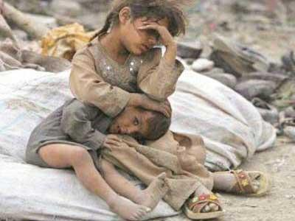
Separations of Human being

Slide 9
The simple example of
Distance,
Classification
and Separation

Slide 10
Houses

Slide 11
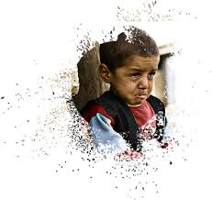
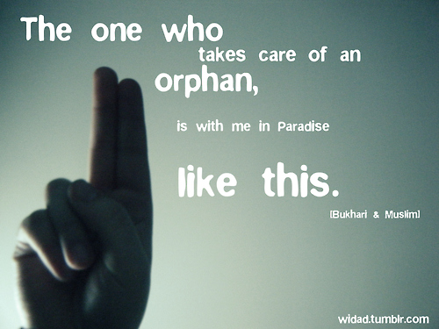
كَلَّا ۖ بَل لَّا تُكْرِمُونَ الْيَتِيمَ ﴿١٧﴾
But no; you do not treat the orphan honorably,
(Al Fajar 17)
You are an Orphan

Slide 12
Does the poor need to be poor / remain poor forever?
That is his personal issue / problem
I am not responsible for their problems
Privacy, Proudness, Selfishness, Hatred

Slide 13
Moreover;
NGOs,
some organizations and
the new life style
performing a good job to make us deprived of
a joint family system,
society,
community and
neighborhood.
Modern education;
Executive, Privacy, Personal, Independent

Slide 14
Islam is the religion of
Brotherhood
Preferences
Solidarity
Respect
Love
Care and
Togetherness

Slide 15
Togetherness creates Love
and Love makes things easy

Slide 16
Islam supports poor through;
Kaffarat >>>> Yamin, Dhehar, Iftar
Fidya Sadaqat Fitr
Nozoor
Hadye
Ud-hiya
Waleema and Aqeeqa
Zakat and Khums
Fay’a
Kharaj and Jizyah
Darayeb and Others
You have to search the beneficiaries and help them

Slide 17
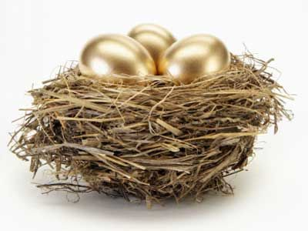
Charitable organizations

Slide 18
I recommend;
Create awearness
Easy to approach, excess
Simple process
Employees must be from poor families
Sincerity and respect to a poor
Management and guidance
Know the problem and provide the solution
Change the status of a poor

Slide 19
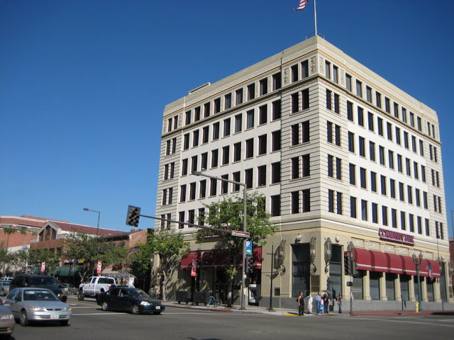
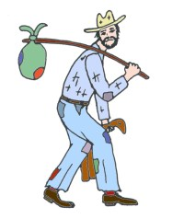
Unfortunately

Slide 20
We have to increase the

Slide 21
A simple and sweet solution
وَأَنكِحُوا الْأَيَامَىٰ مِنكُمْ وَالصَّالِحِينَ مِنْ عِبَادِكُمْ وَإِمَائِكُمْ ۚ إِن يَكُونُوا فُقَرَاءَ يُغْنِهِمُ اللَّهُ مِن فَضْلِهِ ۗ وَاللَّهُ وَاسِعٌ عَلِيمٌ (32)
And marry the unmarried among you and the righteous among your male slaves and female slaves. If they should be poor, Allah will enrich them from His bounty, and Allah is all-Encompassing and Knowing.

Slide 22
Thank you

